Slide 1
Student Health and Wellness (SHaW):
Overview of Services & Requirements
Tuesday, June 21st

Slide 2
Your Health & Wellness Team
Physicians
Nurse Practitioners
Registered Nurses
Registered Dietitians
Pharmacists
Phlebotomists
Radiology Technicians
Psychiatrists
Psychiatric Nurse Practitioners
Psychologists
Marriage & Family Therapists
Clinical Social Workers
Health Promotion Specialists
Health Educators
Recovery Coach

Slide 3
Locations
Medical Care and Pharmacy Hilda May Williams
Mental Health
Arjona (4th floor)
Health Promotion
Wilson Hall (1st floor)
Cordial Storrs
Notes:
SHaW has three locations on the Storrs Campus, including the Hilda May Williams Building, where the majority of Medical Care & Pharmacy Services are offered, Arjona - 4th floor, where all of our clinical mental health services take place, and in Wilson Hall - 1st floor, where our Health Promotion team is housed (but is less of a destination spot than the other two).
Not pictured on the map is the Cordial Storrs House, located on 195 next to East Campus, which is home to the UConn Recovery Community.
While we do important work at each of our three physical locations, we also provide outreach and education across campus.

Slide 4
Languages Spoken at Student Health and Wellness
English
Spanish
Hindi
Marathi
Chinese
German

Slide 5
Our services

Slide 6
Medical Care
The people that take care of you when you’re sick or injured.
Charge | No-Charge
Physical exams | Nutrition and physical activity counseling
Allergy shots | Know-U-Well nurse coach wellness visits
HPV Vaccine | 24/7 Advice Nurse Line
Infirmary If you are too sick to stay in your room, you can stay overnight and a nurse will help you | Flu vaccine
Gynecological & reproductive health care Birth control, STI testing
Radiology – X-Rays
Bloodwork & Lab draw station

Slide 7
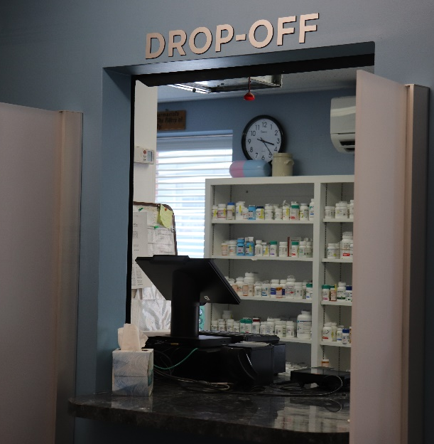
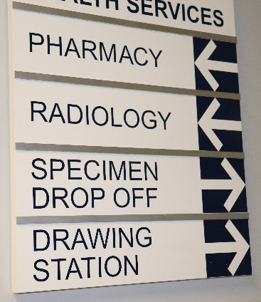
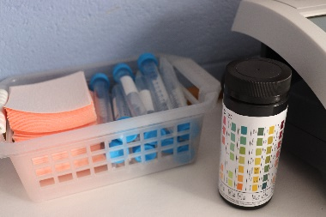
Pharmacy
The people that can help with getting medications
Services:
Prescription medication
Medication management
Over-the-counter medication
Medical supplies

Slide 8
Mental Health
The people that can help support your
mental health
Services:
Individual and group therapy
Case management
“Let’s Talk”
Consultation Hours
Substance use recovery
Mindfulness, Meditation, Yoga
24/7 crisis support

Slide 9
Health Promotion
We help create a culture of health and wellness at UConn through:
Services:
Wellness Coalition
Innovate Wellness
UConn Recovery Community
Health education programs and partnerships
gloveBOX
The UConn Sexperts
BASICS/MAPP

Slide 10
Services
Who CAN Use These Services
Who CAN’T Use These Services?
Students who live in the Storrs Campus residence halls
Students who attend classes at the Storrs campus and live off-campus
Graduate students
Family members
Students from other campuses

Slide 11
How To Make An Appointment
Medical Care
Call 860-486-2719
Mental Health
Call 860-486-4705
Christy Campus

Slide 12
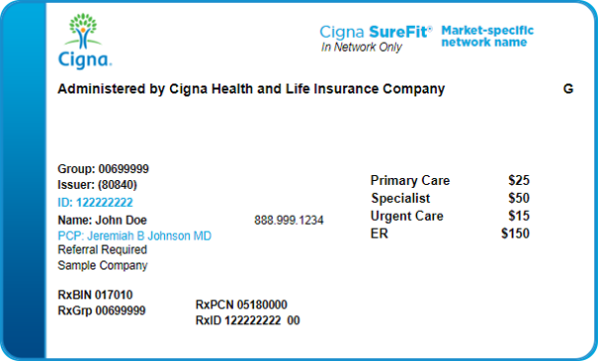
What To Bring To Your Appointment
Your student ID
Your insurance card
Your pharmacy card

Slide 13
After Hours Services (24/7 Services)
After Hours Services are services available to students when our buildings are closed.
Medical Advice Nurse
860-486-4700
Mental Health Crisis Line
860-486-4705

Slide 14
When to Go to Emergency Services
Call 911 in case of an emergency
If you are not sure, call the Advice Nurse
A nurse is available 24 hours a day, 7 days a week to answer your questions

Slide 15
Services Available Off-Campus, but Not at Student Health and Wellness
You will need something called a referral.
Dermatology – for skin care
i.e. acne
Orthopedic – for bones and joints
i.e. you hurt your ankle
Ophthalmology – eye doctor
i.e. you need glasses
Plus, many more. If you do not know what kind of doctor you need, you can always call the Advice Nurse

Slide 16
Health Insurance

Slide 17
How Healthcare is Different in the United States
The United States does not have universal healthcare.
All medical services have a cost.
The cost of services depends on the insurance you have.
With insurance, you may still need to pay a co-pay, co-insurance, or deductible for medical appointments or services
What is a Co-Pay?
A fixed amount ($20, for example) you pay for a covered health care service.
May need to see a general doctor before you can see a specialist

Slide 18
Health Insurance
It is University policy that all full-time students must have medical insurance coverage while at UConn
How much you pay for your plan can determine what is covered
Generally, plans with lower monthly payments have higher deductibles. Plans with higher monthly payments usually have lower deductibles.
Some low-cost plans do not cover preventative care like immunizations and physicals. They only cover you in an emergency.

Slide 19
Health Insurance
Student Health Insurance Plan (SHIP)
Obtain an ID card through the “Wellfleet Cigna” Secure Member Portal Account
Plan you buy yourself (i.e. Medicaid, Access Health, Exchange Plan)
Plan carried by a parent or spouse
Plan provided by an employer

Slide 20
Student Health Insurance Plan (SHIP)
Students will be automatically enrolled in insurance in Fall 2022.
Check your Fall 2022 fee bill. If you were not billed, contact shaw-businessoffice@uconn.edu to be enrolled.

Slide 21
Health Insurance for Families
If you have family here with you at UConn that are not students, it is important they have insurance too.
Spouses or children can be enrolled in the Student Health Insurance Plan (SHIP)

Slide 22
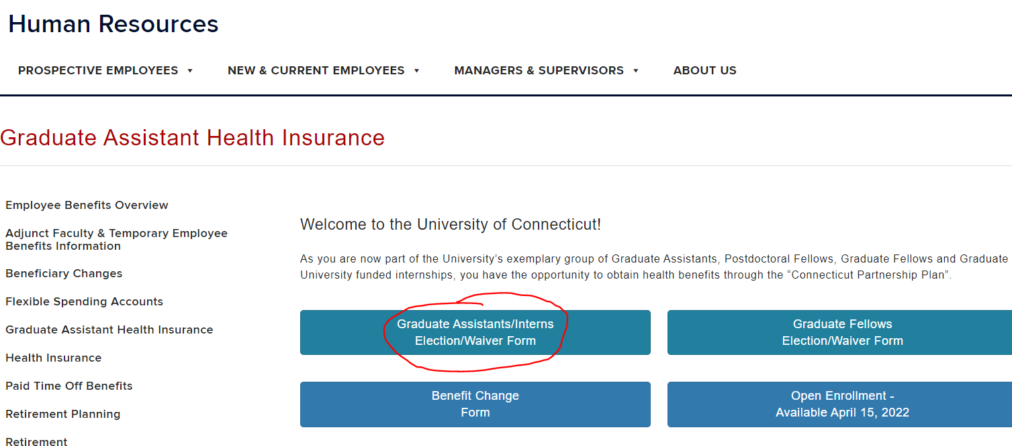
Health Insurance for New Graduate Assistants, Fellows, & Interns
New Graduate Assistants:
You have 31 days from your start date to enrolled in healthcare coverage through the Connecticut Partnership Plan.
Coverage is effective on September 1st, 2022
Failure to enroll means waiting until August 2023.
If you have questions, please contact Human Resources at benefits@uconn.edu or call 860-486-3034.
hr.uconn.edu/ga-health-insurance

Slide 23
VACCINATION REQUIREMENTS

Slide 24
Required Vaccinations (Immunizations)
Measles (or MMR)
Two vaccinations
One after 1st birthday, and one 28 days later OR documentation of positive measles titer (blood test)
Varicella (Chicken Pox)
Two vaccinations
One after 1st birthday, and one 28 days later OR documentation of positive varicella titer (blood test)
Tuberculosis Screening
Complete “Tuberculosis (TB) Risk Assessment” in Student Health Portal.
If you answer “yes” to any question you will need a TB test.
Tuberculosis testing must be done within 6 months of your matriculation date.

Slide 25
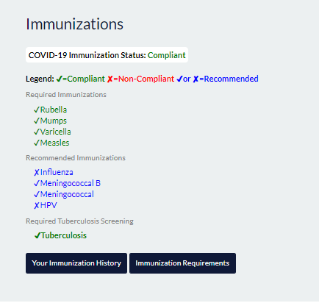
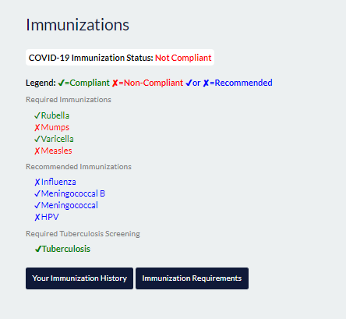
Do I Have To Schedule An Immunization Appointment?
If you are 100% compliant, you do NOT need to schedule an immunization appointment.
If you are NOT compliant, you DO need to schedule an immunization appointment!

Slide 26
Submitting Your Health Requirements
1. Obtain a copy of your official vaccination record from your doctor’s office.
2. Go to your Student Health Portal (myhealth.uconn.edu).
3. Select “Pending Forms” and enter your vaccination information.
4. Upload your official vaccination record OR Health History Form under ‘Document Upload’ on your Student Health Portal (myhealth.uconn.edu)
DUE JULY 1st

Slide 27
AlcoholEDU

Slide 28
AlcoholEdu
August 3rd: Receive email with instructions to access AlcoholEdu
August 8th: Part 1 Opens
August 24th: Part 1 Due
45 Days After Completing Part 1: Part 2 Opens
October 26th: Part 2 Due
Notes:
Facilitator Comments:
AlcoholEdu is an online, interactive prevention program for college students that empowers students to make well-informed, safe decisions about alcohol in order to be successful at UConn. Even if you choose not to drink, you may be around others who drink. AlcoholEdu will provide you with information to support the UConn community.
It's important to note that AlcoholEdu is MANDATORY for all incoming students. Not completing both Part 1 & Part 2 will affect class registration. You’ll receive an email regarding AlcoholEdu that will go to your UConn email address, which includes instructions. Please be aware that Part 1 must be completed on time in order for Part 2 to open 45 days later. There’s an immovable intersession between part 1 and part 2, so completing Part 1 on time is what sets you up to be able to complete part 2 by its respective deadline.
If you have questions or concerns about AlcoholEdu, we encourage you to check out our frequently asked questions page, or email alcoholedu@uconn.edu for assistance.

Slide 29
IMPORTANT DATES

Slide 30
Important Dates
Friday, 7/1/2022 - Deadline to Submit Health History Form
Monday, 8/8/2022 – AlcoholEdu Opens
Thursday, 9/15/2022 – Last day to waive school insurance
Monday, 8/22/2022 - International Graduate Student Orientation

Slide 31
Have Questions About Health Requirements or Insurance?
SHaW Business Office
shaw-businessoffice@uconn.edu
SHaW Health Information Management
studenthealth@uconn.edu

Slide 32
studenthealth.uconn.edu
860-486-4700
studenthealth@uconn.edu

Slide 33
Notes:
Thank you!

